Slide 1
Interdisciplinary Health Data Competition
Team 14: Bailey, Gavin, Grant, and Jack

Slide 2

The Challenge
“Complete an exploratory analysis of the public-use HCAHPS survey to assess how patient experience relates to other aspects of care”
HCAHPS survey
National survey of patients’ hospital experience
Captures patient ratings of various aspects of hospital visit
Notes:
Staff responsiveness, cleanliness, communications

Slide 3
Our Goal
Determine the Hospital attributes that most influence positive patient survey reviews
This will help Hospitals understand key areas of focus they can improve on to better serve patients during difficult times.
Also provides insight into attributes that may be over-invested into, that are not meaningful to patient experience.
Determine the Hospital attributes that most influence positive patient survey reviews
This will help Hospitals understand key areas of focus they can improve on to better serve patients during difficult times.
Also provides insight into attributes that may be over-invested into, that are not meaningful to patient experience.

Slide 4

“Hospital Score” Metric
Average of “Overall Hospital Rating” and “Recommend Hospital” features from HCAHPS survey
Provides a harmonic mean of metrics focused on quality of care, and patient experience

Slide 5
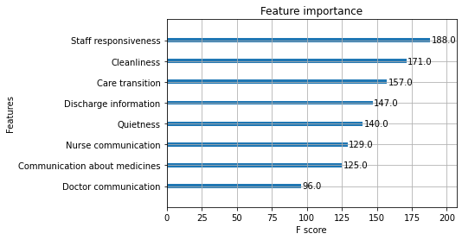
Most Important Factors in Hospital Score

Slide 6
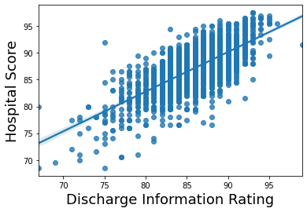
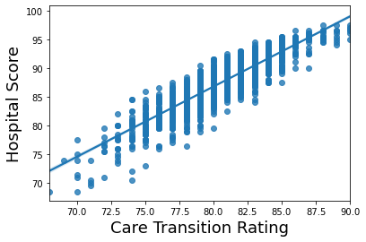
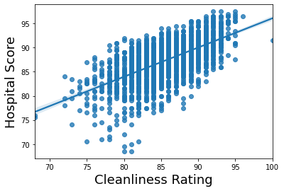
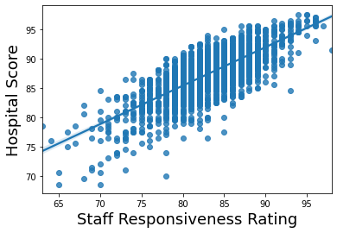
Top 4 Factors in Hospital Score

Slide 7
External Data
The Centers for Medicare & Medicaid Services
Medicare Spending Per Beneficiary
A hospital’s average Medicare reimbursement per patient compared to the national average
Hospital General Information
Ownership, Hospital Type, Emergency Services, ZIP Code
U.S. Census Bureau
Median Income by ZIP Code
Notes:
Jack

Slide 8
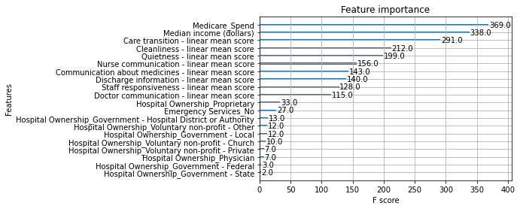
Most Important Factors - with External Data
Outside of Hospitals Control
Within Hospitals Control
Insignificant
Notes:
Jack: medicare spend only negatively correlated feature

Slide 9
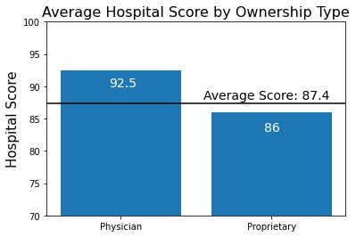
Hospital Ownership
Notes:
Jack

Slide 10
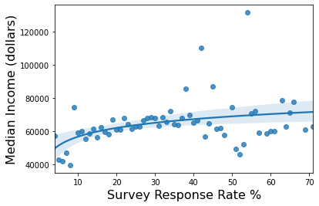
Limitation: Income’s Effect on Survey Responses
Notes:
Jack: “Before we get to our recommendations…”

Slide 11
Recommendations
Utilize Real Time Location Services (RTLS) to Improve Hospital Scores
Staff Responsiveness
Understanding where providers are in relation to patients, wait times on units will be minimized by getting nearest provider to assist patient
Rather than charge nurse or attending physician being paged to room, the closest provider will see patient and determine if additional interventions are necessary
Cleanliness
EVS will be notified as soon as a patient leaves the room, maximizing the cleanliness of the rooms while also improving throughput efficiency
Less downtime for EVS staff, providers, and patients waiting for available beds and rooms to be properly sanitized

Slide 12
Recommendations
Leverage Technology with CareAlign to Improve Hospital Scores
Care Transitions and Discharge Information
CareAlign reduces post-discharge paperwork and allows care teams to contribute collaboratively to discharge plans
Will contribute to more meaningful care transitions and discharges due to improved communication between care teams
Pairs with EHR to enhance clinical workflows, including ability to attach to EHR as note or print out for paper charts
Will pay for itself in reduction of communication-related errors around the time of care transition or discharge

Slide 13
Sources
CareAlign Information Technology
Hospital General Information (CMS)
Medicare Spending Per Beneficiary (CMS)
Median Income by ZIP Code (U.S. Census Bureau)
RTLS Technology in Healthcare

